Slide 1
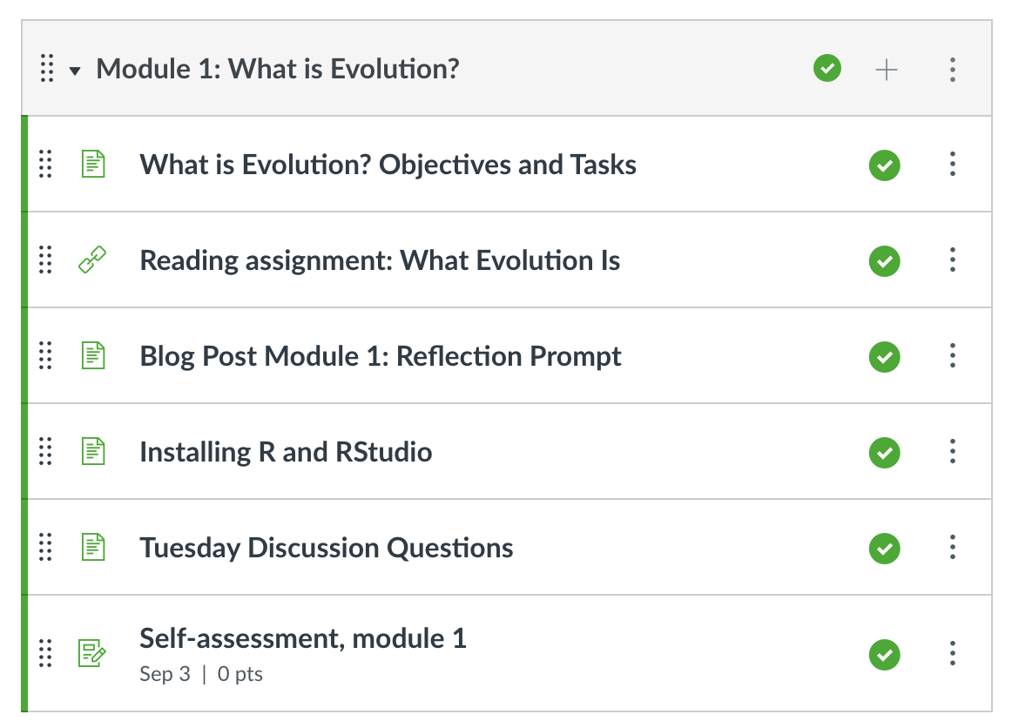
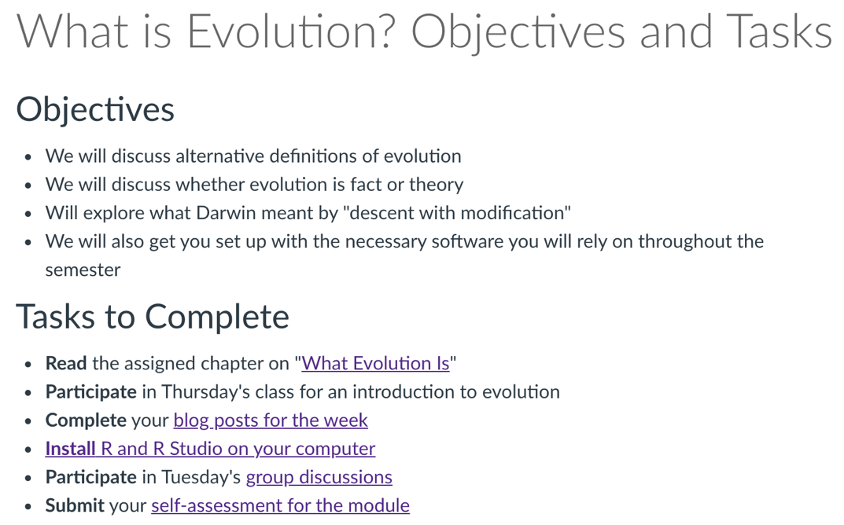

Slide 2
What is evolution?
And what is not?

Slide 3
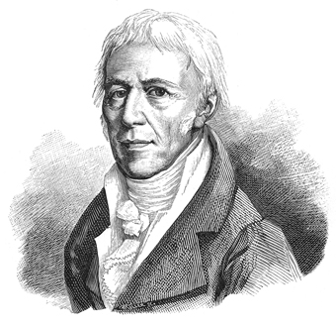
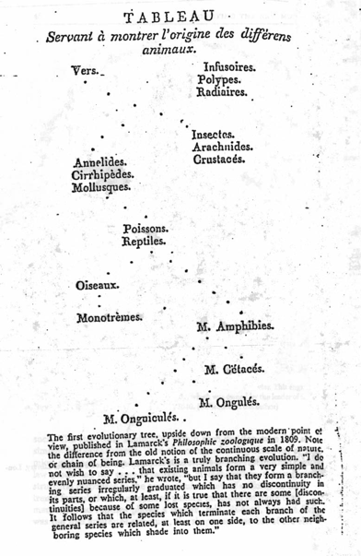
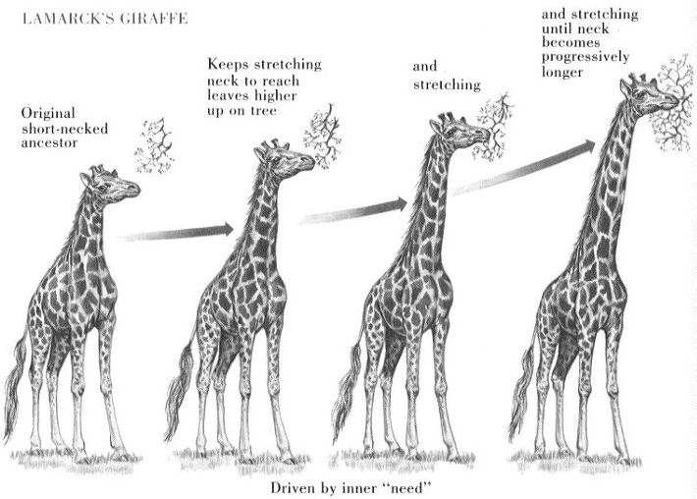
Evolution was not Darwin’s idea
Jean-Baptiste de Lamarck
Climbing a ladder of progress
Change is driven by an “inner need”

Slide 4
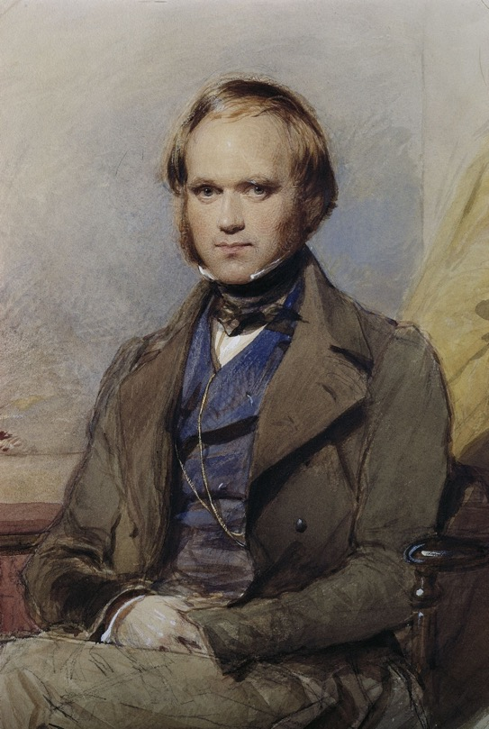
Collecting clues about the ever changing world
The voyage of the Beagle

Slide 5
Collecting clues about the ever changing world
Examining specimens and breeding pigeons

Slide 6
Darwin’s two fundamental insights
Descent with modification
All species on Earth are related
Inherited traits are modified over time
This is the pattern of evolution
Natural selection
Modifications happen through selection on heritable traits
This is the mechanism that explains the pattern

Slide 7
The pattern of evolution: descent with modification

Slide 8
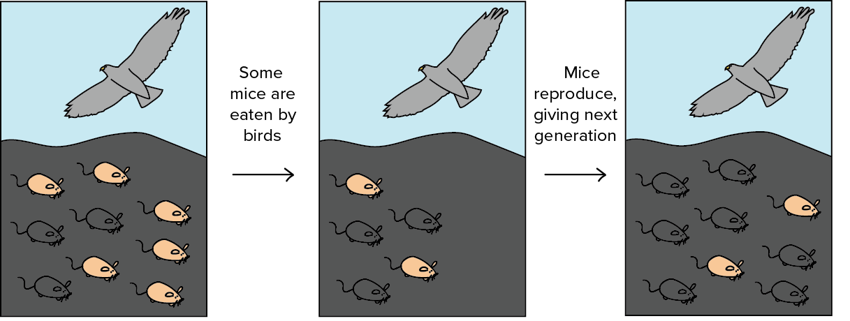
The pattern of evolution: descent with modification
Darwin’s hypothesis of descent with modification makes five key predictions
Species change through time (microevolution)

Slide 9
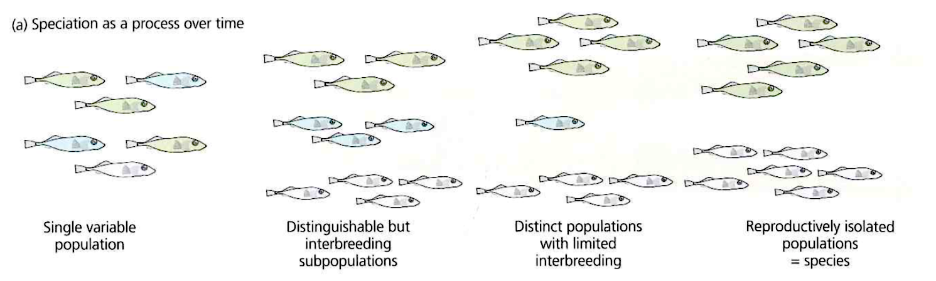
The pattern of evolution: descent with modification
Darwin’s hypothesis of descent with modification makes five key predictions
Species change through time (microevolution)
Lineages split and diverge (speciation)

Slide 10
The pattern of evolution: descent with modification
Darwin’s hypothesis of descent with modification makes five key predictions
Species change through time (microevolution)
Lineages split and diverge (speciation)
Novel forms derive from earlier forms (macroevolution)

Slide 11
The pattern of evolution: descent with modification
Darwin’s hypothesis of descent with modification makes five key predictions
Species change through time (microevolution)
Lineages split and diverge (speciation)
Novel forms derive from earlier forms (macroevolution)
Species are not independent, but are connected by descent from common ancestors

Slide 12
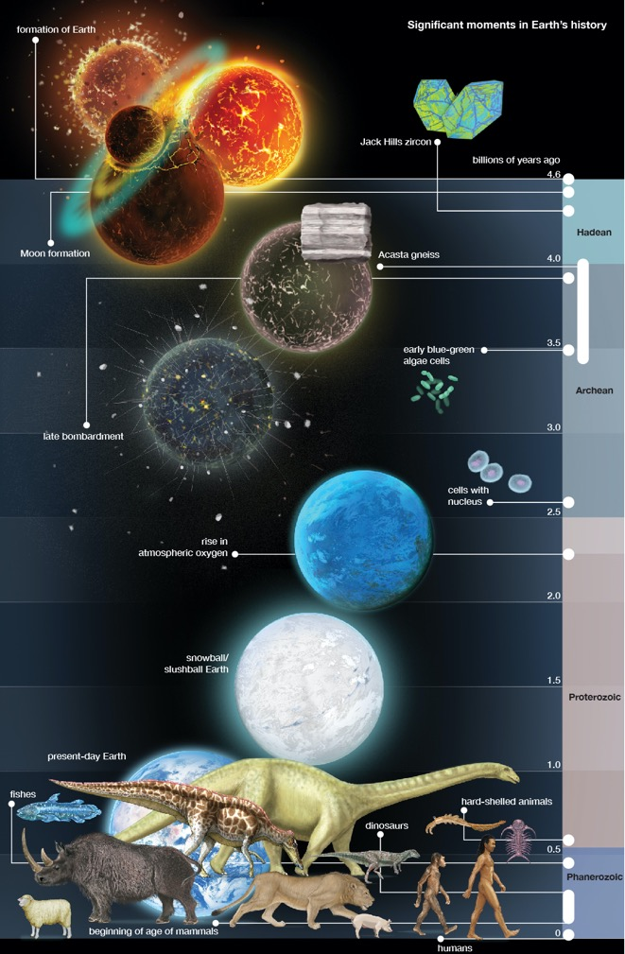
The pattern of evolution: descent with modification
Darwin’s hypothesis of descent with modification makes five key predictions
Species change through time (microevolution)
Lineages split and diverge (speciation)
Novel forms derive from earlier forms (macroevolution)
Species are not independent, but are connected by descent from common ancestors
Earth and life are old

Slide 13
Installing R and RStudio
Mac
Download the .pkg file for R 4.1 form here: https://cran.r-project.org/bin/macosx/
Download RStudio from here: https://rstudio.com/products/rstudio/download/preview/
For Windows
Download the binary setup file for R 4.1 from here: https://cran.r-project.org/bin/windows/base/
Download the binary setup file for Rtools40 from here: https://cran.r-project.org/bin/windows/Rtools/
Download RStudio from here: https://rstudio.com/products/rstudio/download/preview/

